Slide 1
IBIS Matrix Equation
Chenyu Bian, Lifen Jiang

Slide 2
GPP
CO₂
NPP
Leaf
Wood
Root
Decomposable plant matter
(leaf litter, fine roots, wood)
Structural plant matter
(leaf litter, fine roots, wood)
Resistant (lignin) plant matter
(leaf litter, fine roots, wood)
CO₂
CO₂
Protected slow C
Microbial C
CO₂
Unprotected slow soil C
CO₂
Leaching
Passive slow C
CO₂
Carbon flow diagram of IBIS
Kucharik et al. 2000

Slide 3
GPP
CO₂
NPP
b1
b2
b3
Leaf (X1)
Wood (X2)
Root (X3)
Decom Leaf L (X4)
Decom Wood L (X5)
Decom Root L (X6)
Str
Leaf L (X7)
Str Wood L (X8)
Str
Root L (X9)
Lignin
Leaf L (X10)
Lignin
Wood L (X11)
Lignin
Root L (X12)
CO₂
CO₂
Microbial C (X13)
Protected slow C (X14)
CO₂
Unprotected slow soil C (X15)
CO₂
Leaching
Passive slow C (X16)
CO₂

Slide 4
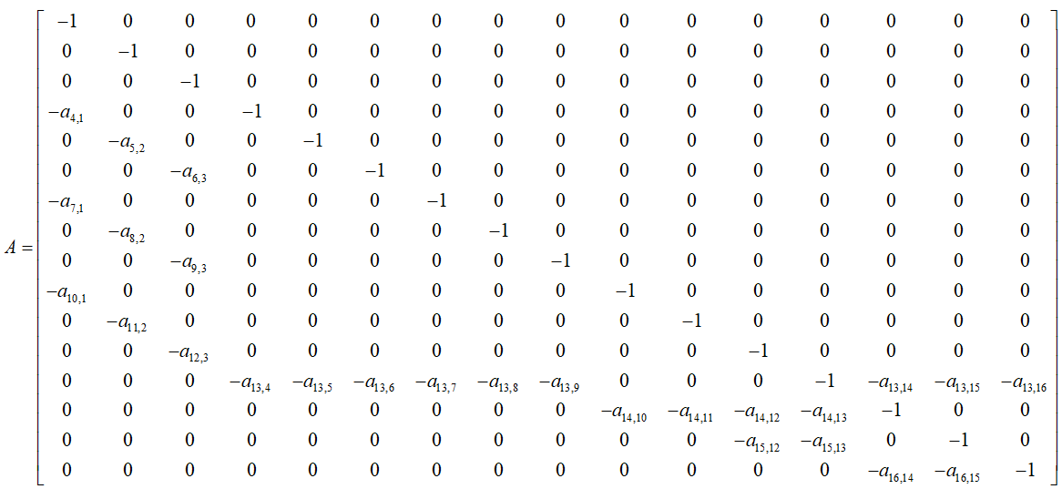
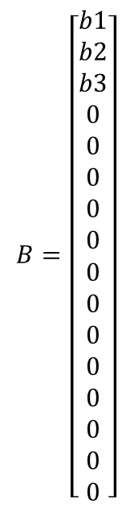
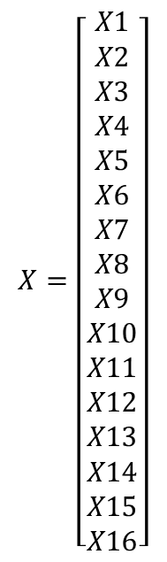
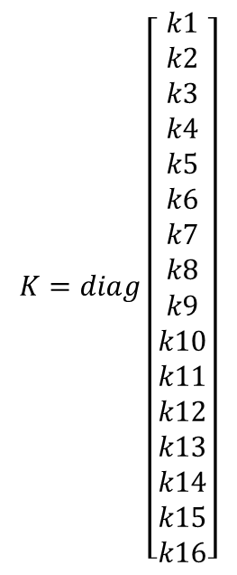
$$\frac{dX}{dt}=BI(t)+AKX(t)$$
$$B=\left[\begin{aligned}b1 \\ b2 \\ b3 \\ 0 \\ 0 \\ 0 \\ 0 \\ 0 \\ 0 \\ 0 \\ 0 \\ 0 \\ 0 \\ 0 \\ 0 \\ 0\end{aligned}\right]$$
$$K=diag\left[\begin{aligned}k1 \\ k2 \\ k3 \\ k4 \\ k5 \\ k6 \\ k7 \\ k8 \\ k9 \\ k10 \\ k11 \\ k12 \\ k13 \\ k14 \\ k15 \\ k16\end{aligned}\right]$$
$$X=\left[\begin{aligned}X1 \\ X2 \\ X3 \\ X4 \\ X5 \\ X6 \\ X7 \\ X8 \\ X9 \\ X10 \\ X11 \\ X12 \\ X13 \\ X14 \\ X15 \\ X16\end{aligned}\right]$$

